Slide 1
PD Online / 21 Things
All links are available at KDhandouts.weebly.com

Slide 2
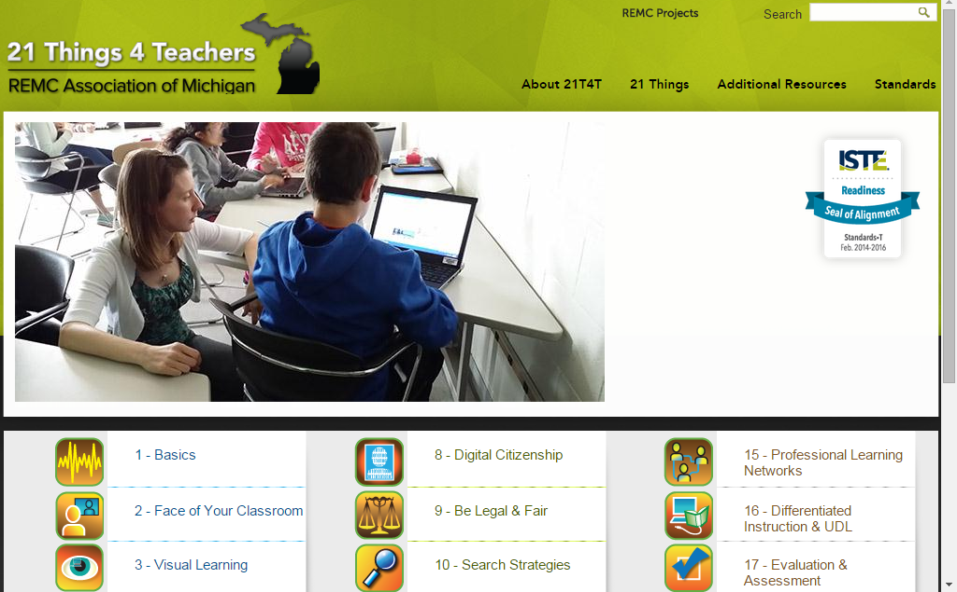
21 Things 4 Teachers
www.21things4teachers.net/

Slide 3
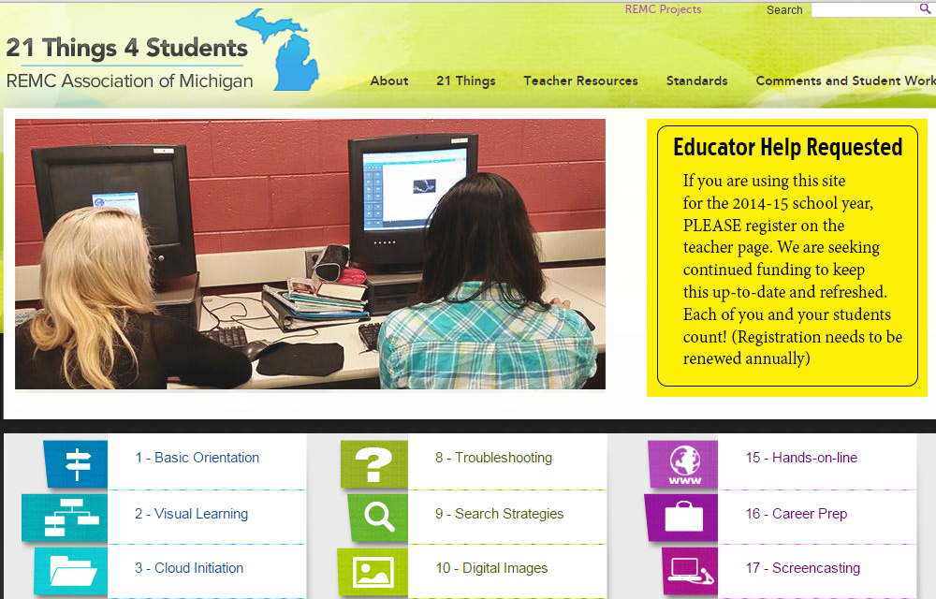
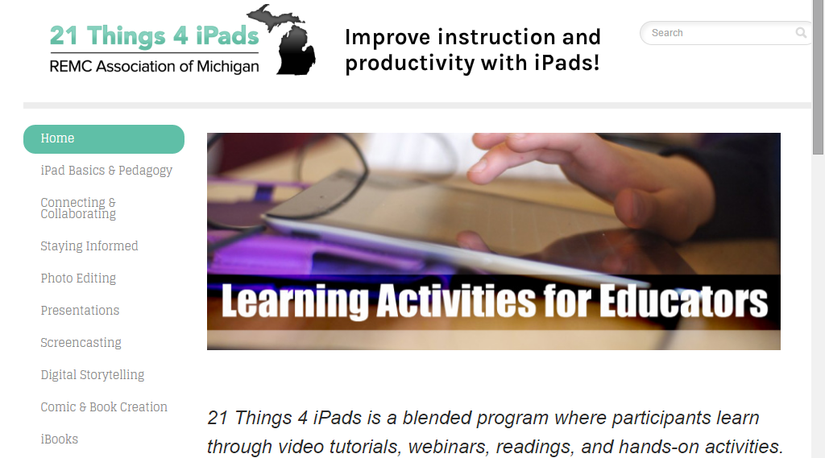
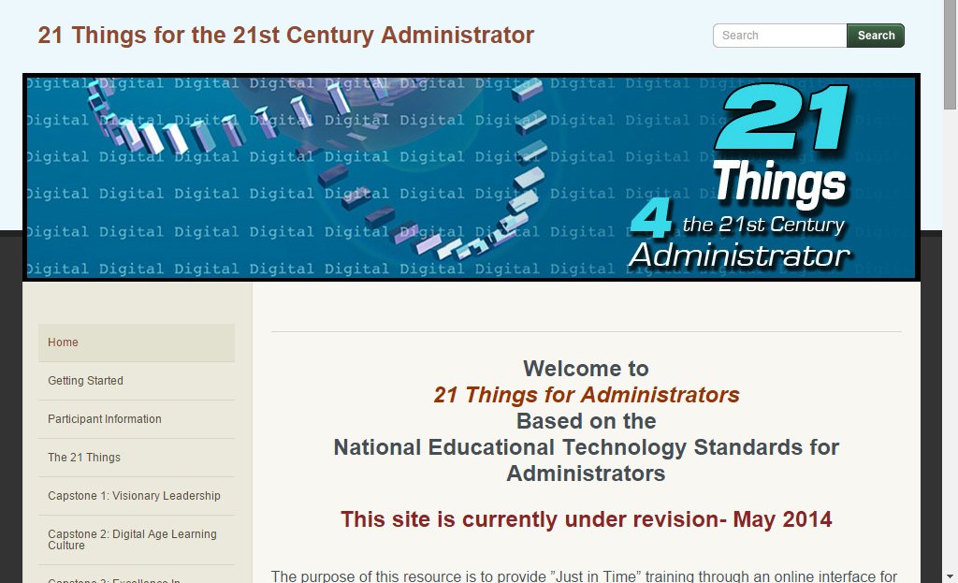
More 21 Things…
www.21things4administrators.net
www.21things4students.net
www.21things4ipads.net

Slide 4
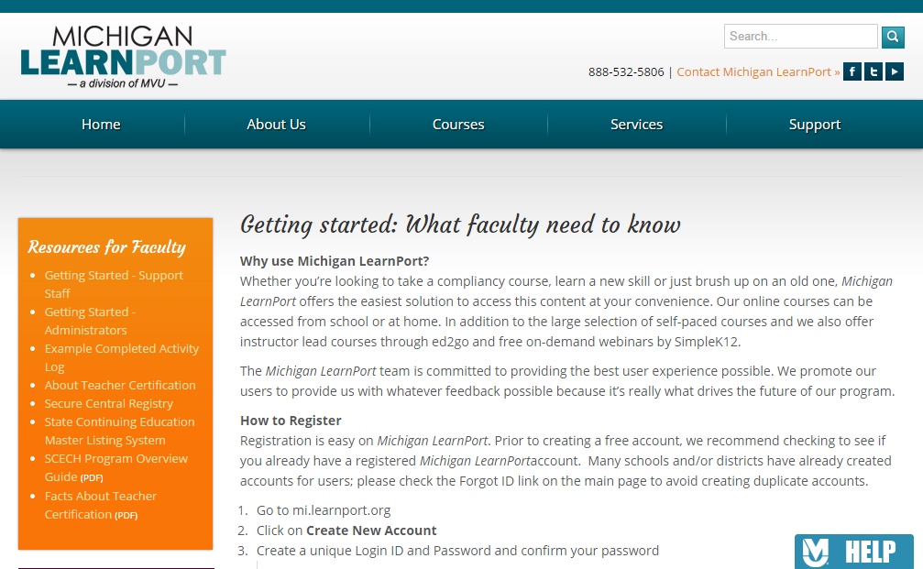
Michigan LearnPort http://www.learnport.org/

Slide 5
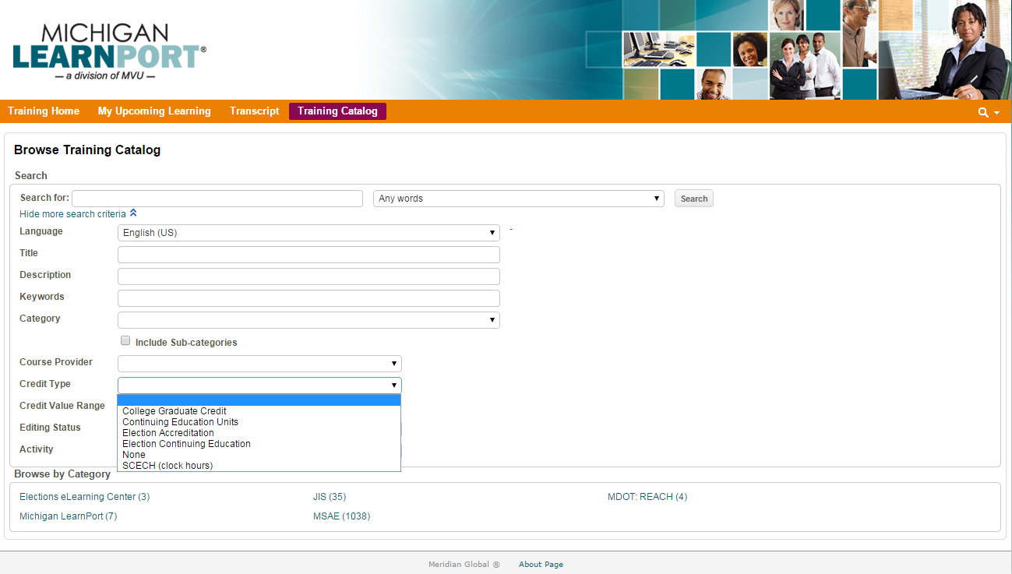
Michigan LearnPort

Slide 6
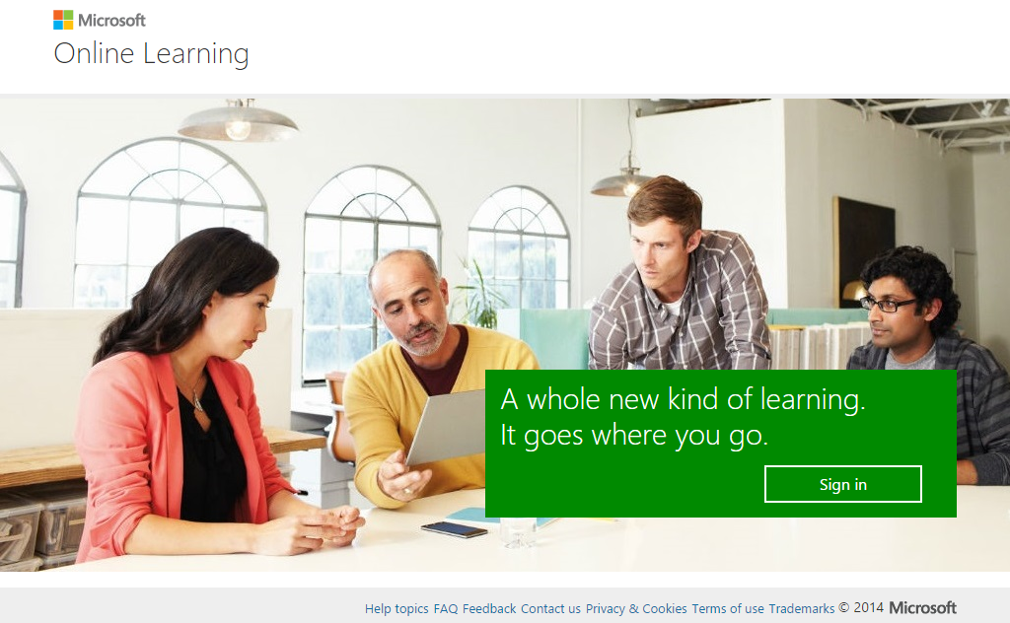
Microsoft Online Learning http://onlinelearning.microsoft.com
Login with your “Organizational Account”. (jsmith@anchorbay.onmicrosoft.com)

Slide 7
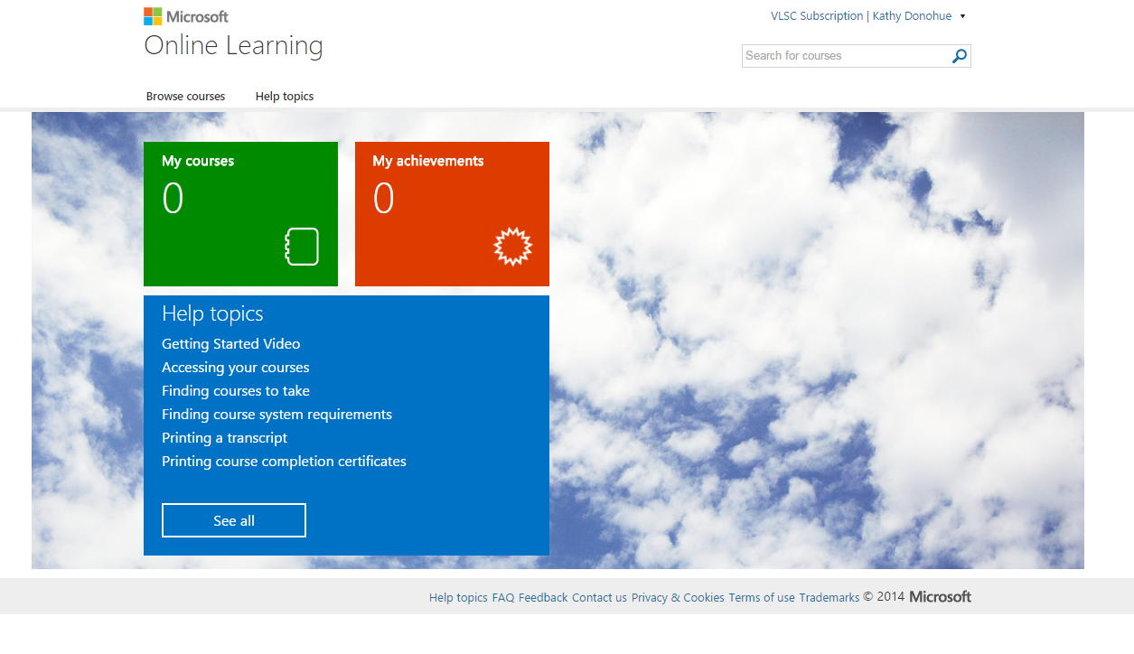
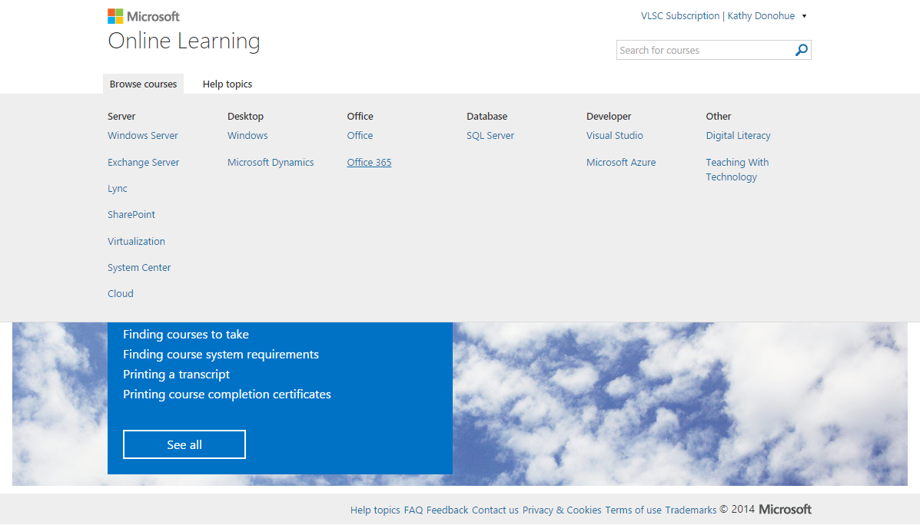
Microsoft Online Learning http://onlinelearning.microsoft.com

Slide 8
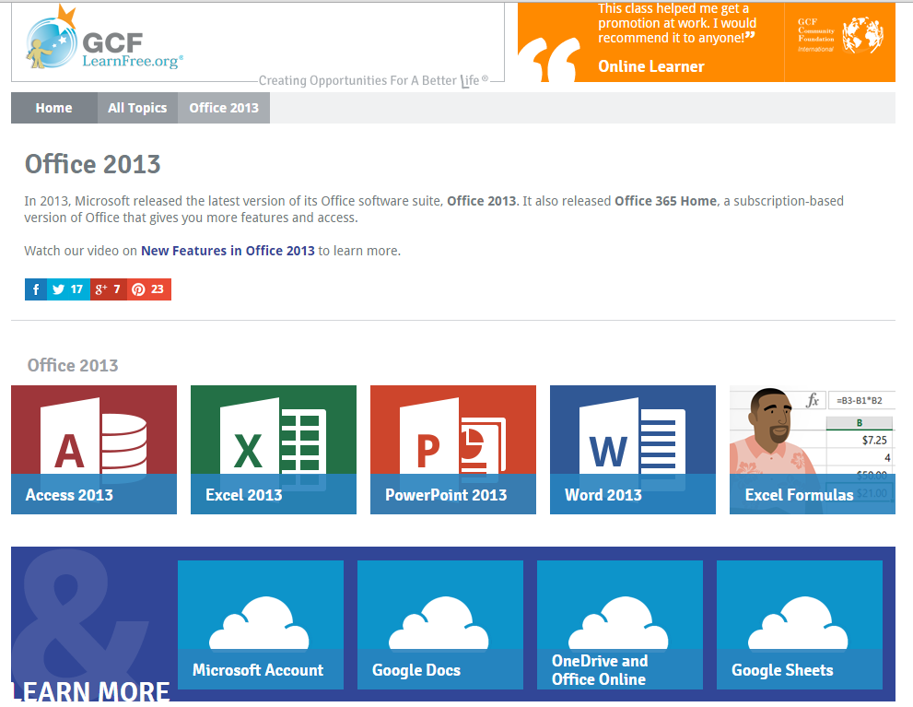
Microsoft 365 and Office 2013 GCF LearnFree
www.gcflearnfree.org/office2013

Slide 9
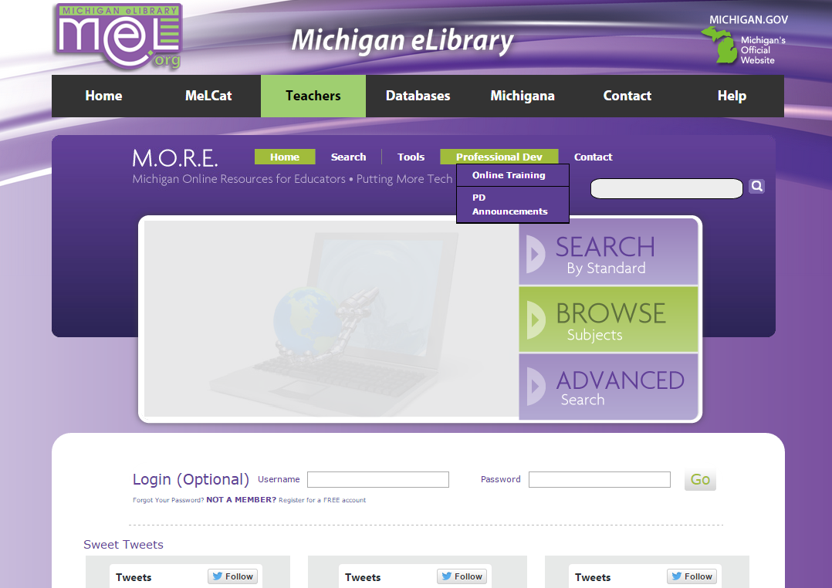
MeL: Michigan Online Resources for Education
http://more.mel.org

Slide 10
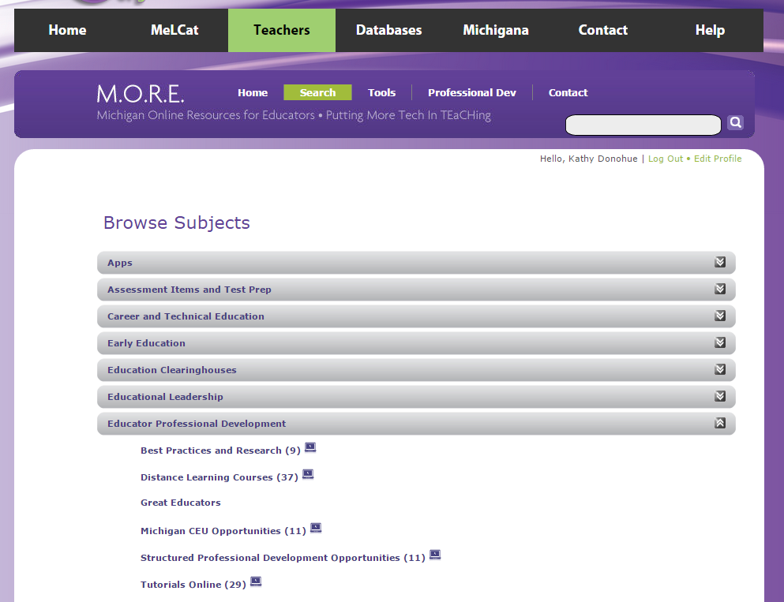
MeL: Michigan Online Resources for Education

Slide 11
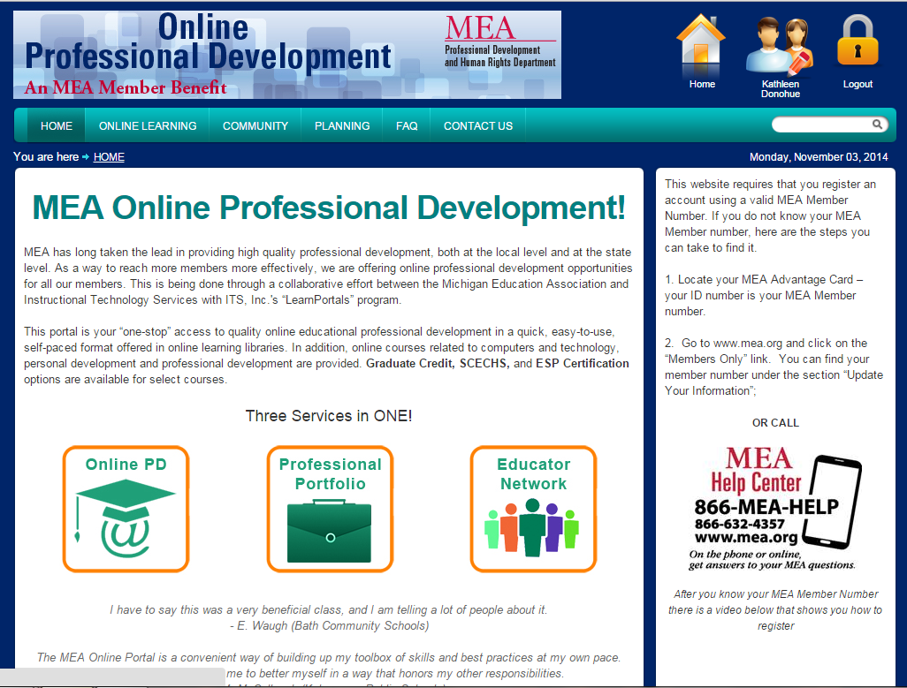
MEA Online PD
mea.learnportals.com

Slide 12
MEA Online PD

Slide 13
http://KDhandouts.weebly.com

