Slide 1
VIDEO
Notes:
Essential Reports Chart
Timing: 5 minutes
Purpose:
Note-taking device for participants
Exploring the Class Report
Timing: 15 minutes
Purpose:
Participants access, interpret, and apply data from the Class Report

Slide 2
Class Report
SEE HANDOUT FOR EXAMPLE
Displays the teacher’s class data for the current testing term by RIT score
The mean moves up for each testing period.
Notes:
Essential Reports Chart
Timing: 5 minutes
Purpose:
Note-taking device for participants
Exploring the Class Report
Timing: 15 minutes
Purpose:
Participants access, interpret, and apply data from the Class Report

Slide 3
Class Report
Summary and Overall Performance page indicates the specific goal areas of the given test.
Reports number of students in performance areas from Lo to Hi.
Reports “Mean RIT” for the class and “Norm Grade Level Mean RIT” based on a diverse group of students tested from across the country.
Notes:
Essential Reports Chart
Timing: 5 minutes
Purpose:
Note-taking device for participants
Exploring the Class Report
Timing: 15 minutes
Purpose:
Participants access, interpret, and apply data from the Class Report

Slide 4
Achievement Status and Growth Report
SEE HANDOUT FOR EXAMPLE
Displays each student’s term-to-term growth and shows how that growth relates to the student’s growth projections.
Growth projections are developed based on the latest NWEA norming study.
Notes:
Essential Reports Chart
Timing: 5 minutes
Purpose:
Note-taking device for participants
Exploring the Class Report
Timing: 15 minutes
Purpose:
Participants access, interpret, and apply data from the Class Report

Slide 5
Achievement Status and Growth Report
Did RIT scores go up or down?
If down, why? (e.g. Special Ed student, rushed through test, scored extremely high in the Fall)
If no obvious reason, what does the student need in order to increase the score in the next round of testing?
Notes:
Essential Reports Chart
Timing: 5 minutes
Purpose:
Note-taking device for participants
Exploring the Class Report
Timing: 15 minutes
Purpose:
Participants access, interpret, and apply data from the Class Report

Slide 6
Class Breakdown by Goal Report
Displays the teacher’s class data by subject and by RIT for current test term. FIX
Notes:
Timing: 10 minutes (of 45)
Purpose:
Participants explore annotated Class Breakdown by RIT and Class Breakdown by Goal reports.

Slide 7
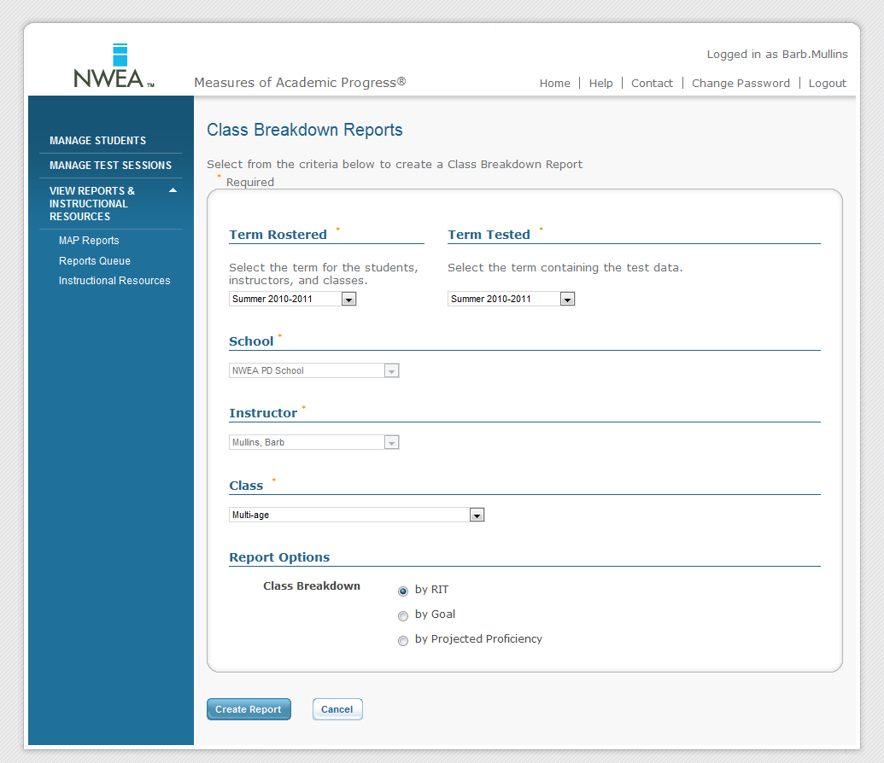
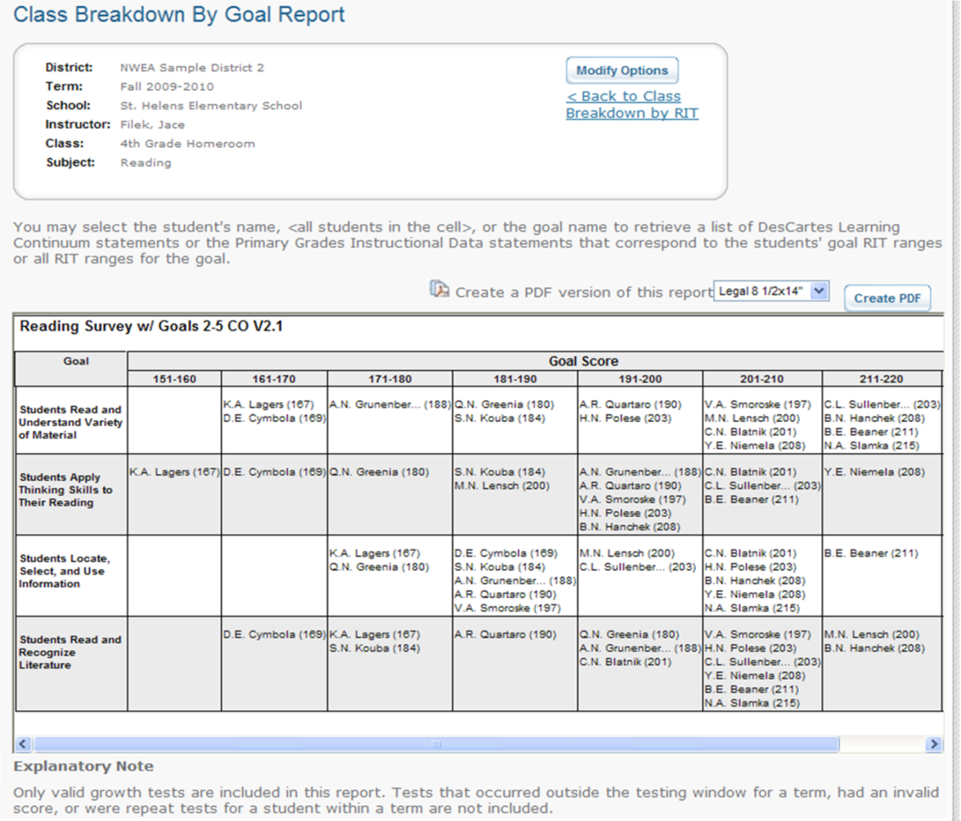
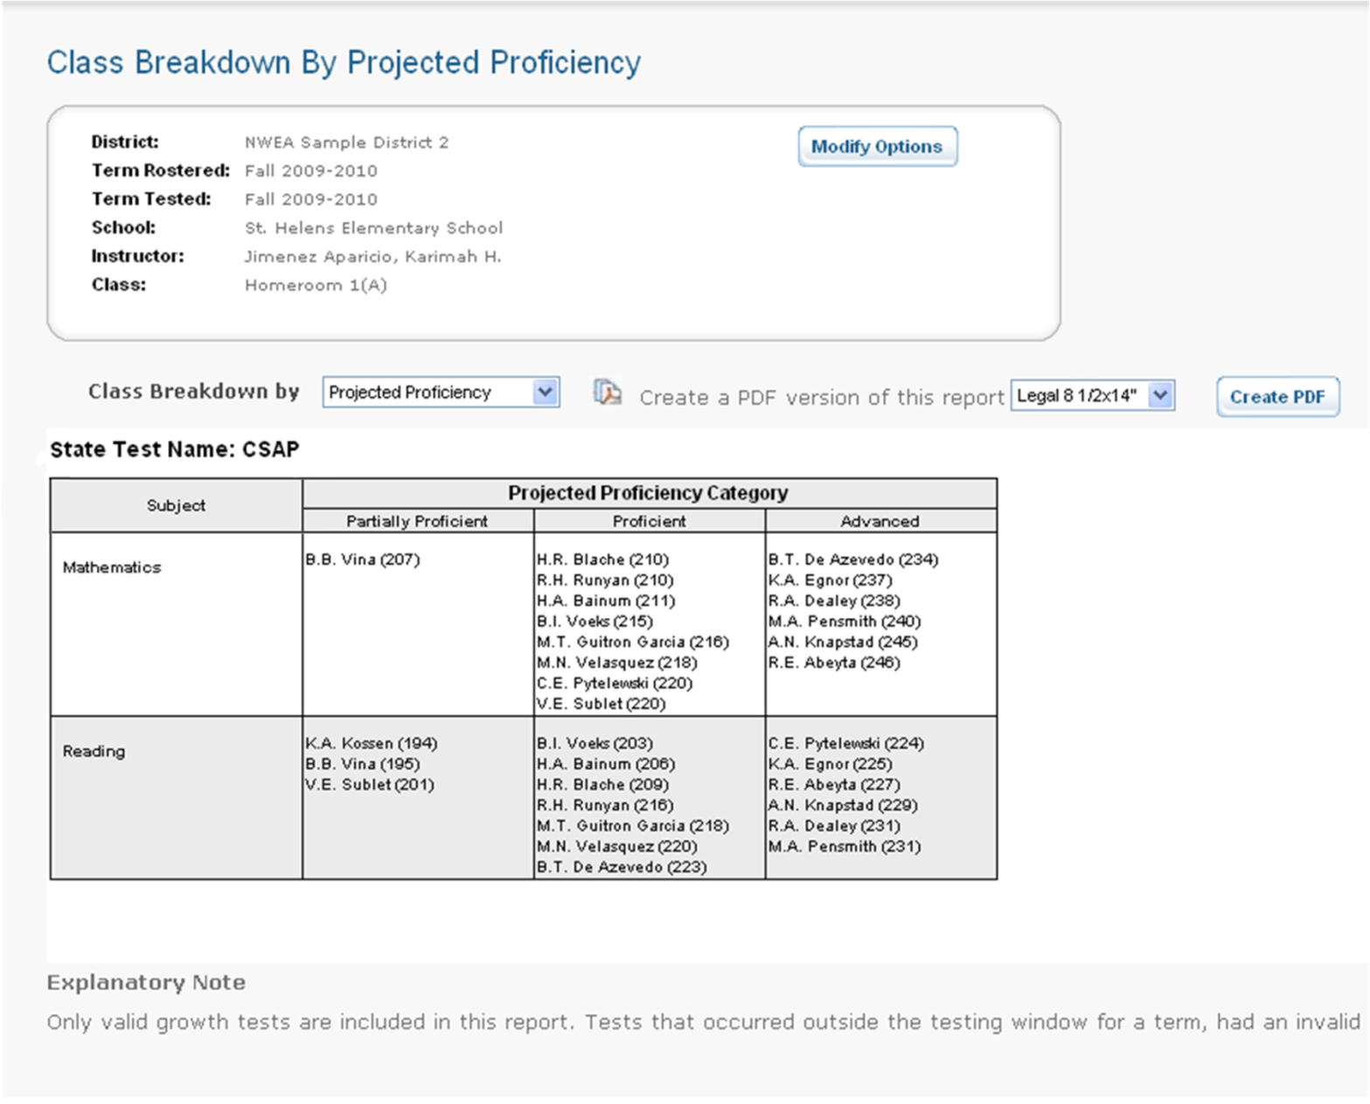
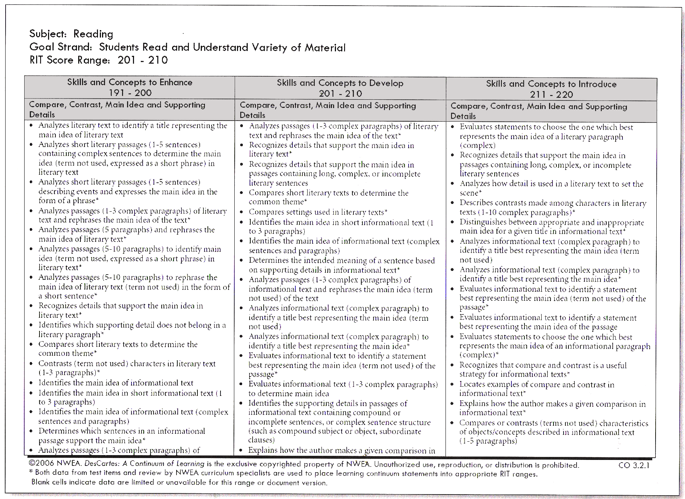
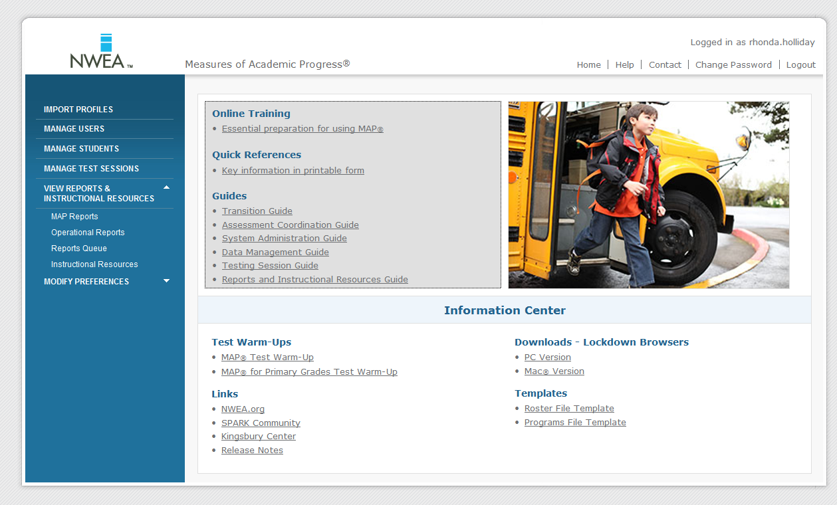
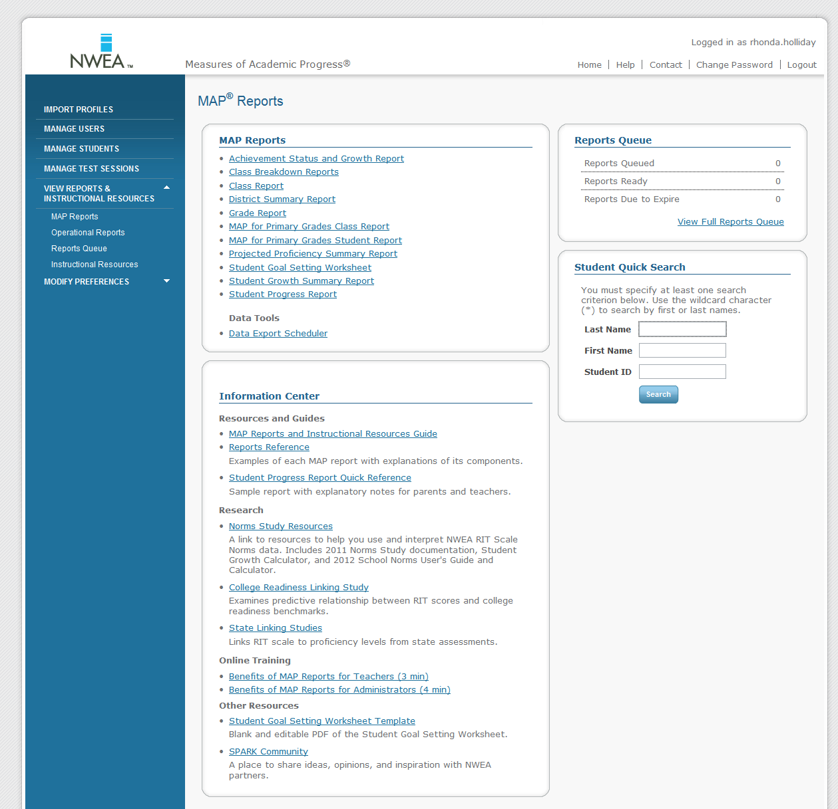
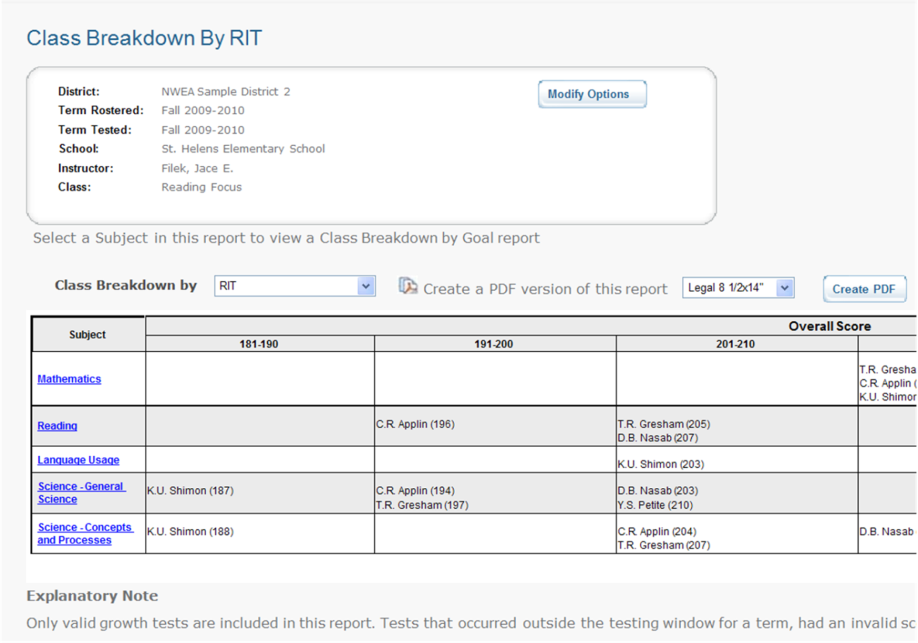
Class Breakdown Reports and DesCartes: A Continuum of Learning®
Notes:
Timing: see slide 11
Purpose:
This slide illustrates the process of accessing the Class by RIT and drilling down to Breakdown by Goal Area and DesCartes, including animations.

Slide 8
Before you print…
Click on START in the lower, left corner of the desktop then SETTINGS.
Choose PRINTERS AND FAXES
Right-click on the “XXXXXXXXX” and choose Set as Default Printer

Slide 9
To get to the NWEA site…
Open Internet Explorer
Click on DEPARTMENTS then TECHNOLOGY
Click on the “NWEA Proctor” link in the right Quick Links menu

Slide 10
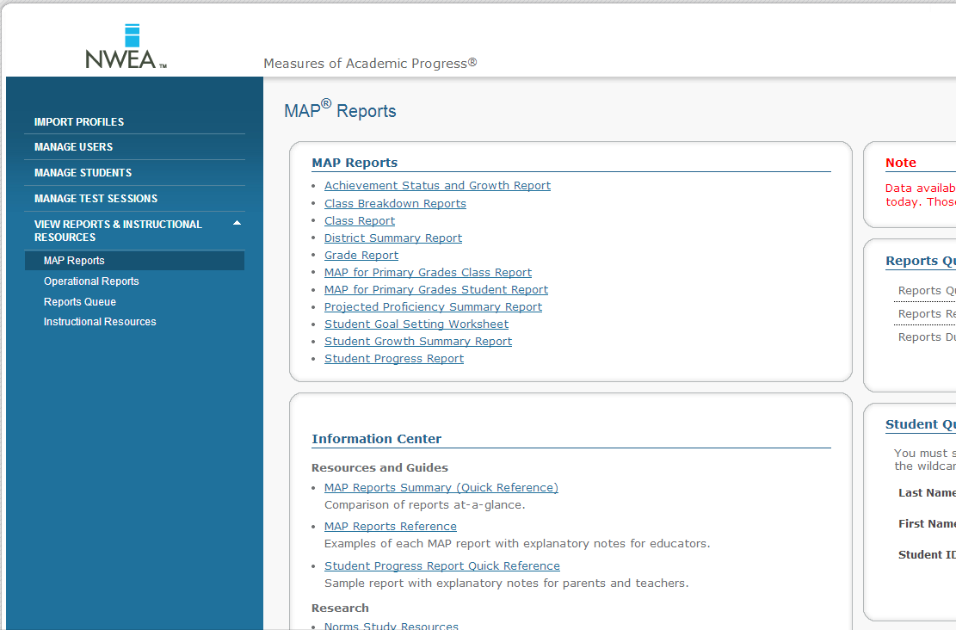
After logging in…
Click on View Reports and Instructional Resources then MAP Reports. Choose Winter 13-14.

Slide 11
What to do with the reports…
Grades 1 to 5: Go to the K-5 Shared drive then Maconce—MAP PD 3-12-14 and open the “MAP Skills—Goals Math and Reading” file.
Using the Class Breakdown Report, fill in the names of the students under the appropriate RIT level
Which skills do you want to work on with those students?

Slide 12
Kindergarten Report
Go to the K-5 Shared drive then Maconce—MAP PD 3-12-14 and open the “Comparing Kindergarten MAP Scores” file.
Follow the instructions to create a comparison of Fall to Winter performance.

Slide 13
Other Resources
Go to the K-5 Shared drive then Maconce—MAP PD 3-12-14 and open the “NWA MAP Resources” file.
This file includes links to MAP discussion boards, Pinterest pages, and online activities categorized by RIT.

