Slide 1
Bookshare: Books without Barriers
Adapted from Bookshare 8-27-14

Slide 2
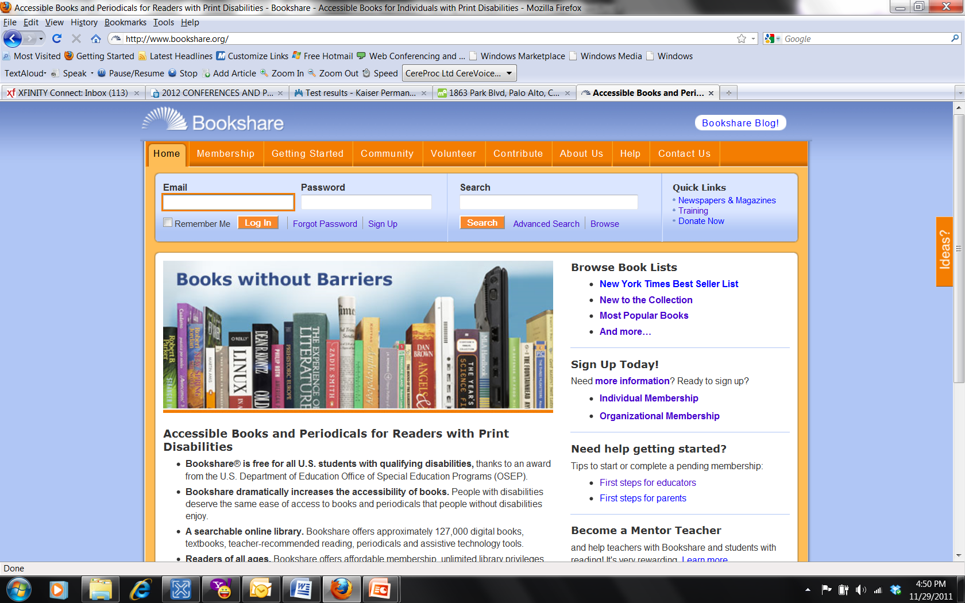
Introducing…Bookshare!

Slide 3
Bookshare Overview
Bookshare® is an online library of digital books for people with print disabilities.
It operates under an exception to U.S. copyright law which allows copyrighted digital books to be made available to people with qualifying disabilities. In addition, many publishers and authors have volunteered to provide Bookshare with access to their works.
By requiring individuals to register as Members and provide a Proof of Disability, Bookshare ensures that only qualified individuals use the service.

Slide 4
Bookshare Overview
Bookshare Members download books, textbooks and newspapers in a compressed, encrypted file.
They then read the material using adaptive technology, typically software that reads the book aloud (text-to-speech) and/or displays the text of the book on a computer screen, or Braille access devices, such as refreshable Braille displays.

Slide 5
What Makes
Bookshare Possible?
Legal basis: Operates under the Chafee Amendment to U.S. Copyright Law
  http://www.loc.gov/nls/reference/factsheets/copyright.html
Financial basis: Funded by award from the Office of Special Education Programs (OSEP) at the U.S. Dept of Education

Slide 6

What Bookshare Offers
Digital books for individuals with print disabilities
FREE memberships for qualified U.S. students through OSEP award
FREE assistive technology software
Compatibility with a variety of assistive technology
Notes:
6

Slide 7
The Bookshare Library
Textbooks
  +3,200 K-12 textbooks w/images
  College/University textbooks
Classroom Reading Books
Special Collections
  New York Times Best Sellers
  Newbery, Caldecott Winners
  1,000 books in Spanish
More than 175 publisher partnerships
270 nat’l/reg’l newspapers/magazines
As of December 2011
Bookshare
is committed to
high-quality books. Please report any quality issues on the book download page.
Notes:
7

Slide 8
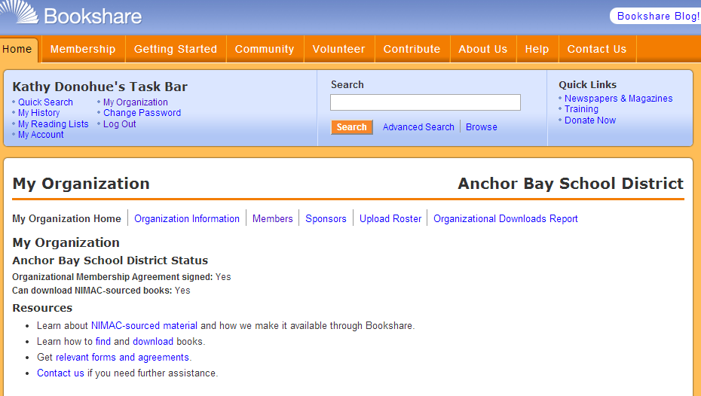
Students = “Members”
Educational Staff = “Sponsors”
Notes:
8

Slide 9
Add One or More Sponsors
Sponsors download books for students
  An account can have many Sponsors
  Primary Contacts can also download books
Sponsors agree to terms
Each Sponsor has his/her own password
Sponsor examples:
Teacher, VI teacher, Special Education teacher, Special Education Director, Itinerant teacher, AT Specialist, Resource Specialist, Librarian, Counselor, Administrative Assistant
Notes:
9
The Primary Contact is the point of contact for the account services. He or she can add any number of Sponsors or ‘downloaders’ to the account so that other educational staff can also have access to the account to download books
Primary contact is not the Certifying Professional

Slide 10
How to Create a Bookshare “Sponsor”
Someone who is already a district Sponsor can add a new Sponsor. Sponsors are additional educational professionals who will download for or share titles with students.
Login to Bookshare. Click on “My Organization”. Select the "Sponsors" link and use the "Add a Sponsor" button.
Each new Sponsor will receive a welcome email with a link to set his or her password.
Notes:
10

Slide 11
Complete the Registration: Your “Welcome” Email
Check your Inbox as well as your spam filter
Open and read the email
Select link on bottom of page
Create your password

Slide 12
Two Membership Options for Students
Individual Membership
Access Bookshare at Home
Student downloads for herself / himself
Organizational Membership
Teacher downloads on behalf of student
Download books, except textbooks, up to 100 per month
Download all books, including textbooks
Access Bookshare at School
Notes:
Describe both types of memberships and the differences between the two.
Stress that Bookshare recommends getting both types of memberships, and parents play a critical role in getting that access.

Slide 13
Bookshare Eligibility
Record of disability kept at school!
Notes:
13
This is a table that clarifies eligibility. The list of certifying professionals applies to all categories.

Slide 14
Video: Qualifying Disabilities
https://www.youtube.com/watch?v=ZOaibjhIh9k&feature=youtu.be
Notes:
14

Slide 15
How to Add a Bookshare “Member”
Login to Bookshare and choose “My Organization”. To add Members: Select the "Members“ link.
Fill in the requested information including the type of Print Disability.
If you want to send the parent an email or form to set up an Individual Membership for the student, choose that button and fill out the information.
Notes:
15
These are the high level steps involved with creating an account. We’ll now walk through all the details covering these basic steps.

Slide 16
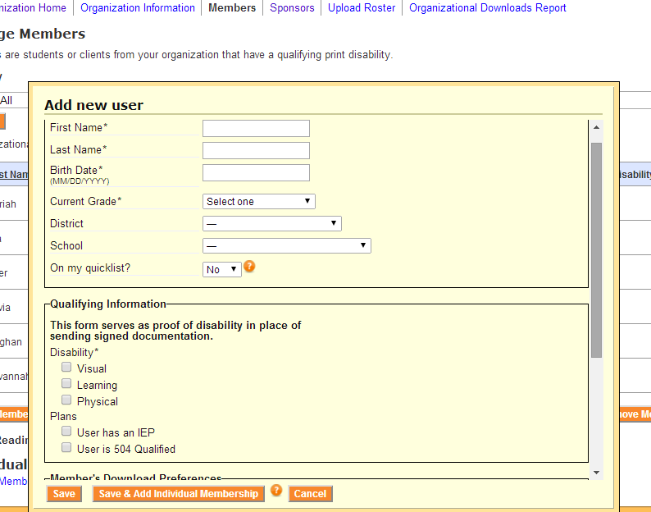
Demonstration: Adding Members and Sponsors

Slide 17
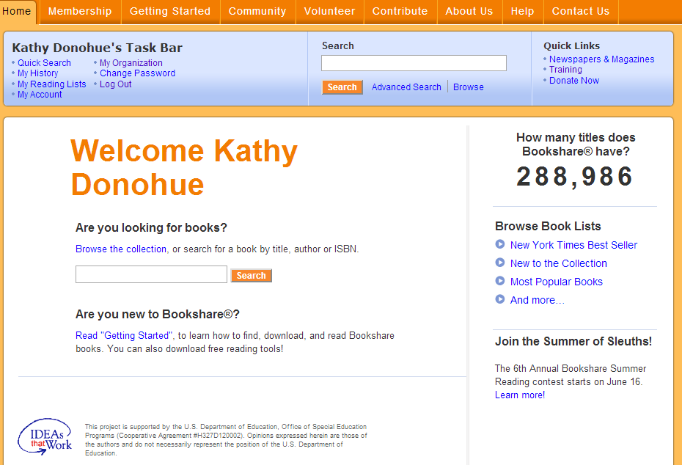
Demonstration: Searching for Books

Slide 18
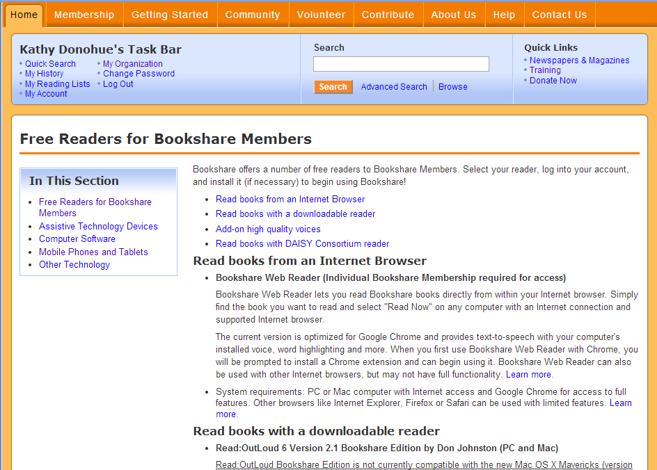
Free and Low-Cost Readers

Slide 19
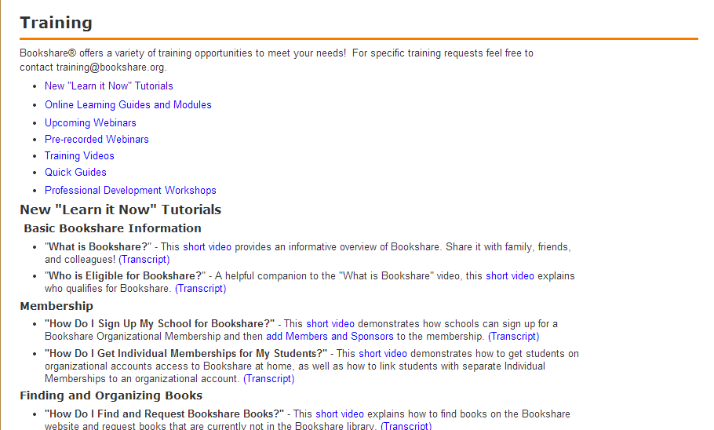
Demonstration: Training Videos

Slide 20
Resources
Bookshare is located at https://www.bookshare.org/
Getting Started overview https://www.bookshare.org/_/gettingStarted/overview
Training videos: https://www.bookshare.org/_/help/training/upcomingWebinars and https://www.bookshare.org/_/community/educators/training
Chart of Qualifying Disabilities: https://www.bookshare.org/_/membership/qualifications
Free and low-cost readers for various devices https://www.bookshare.org/readingTools

Slide 21
Other Examples of Digital Book Sources
MeL: Michigan eLibrary http://mel.org/
Choose the appropriate age group. Sources include:
Bookflix: Video + Text fictional stories paired with read aloud informational books
eBook K-8 Collection
Teens—Reading Zone: Links to full length eBooks, comics, zines, and audio books
Chesterfield Public Library http://www.chelibrary.org/
Click on eBooks or eMagazines in the left column

